Slide 1
2025 NCAC Membership Plan

Slide 2
Table of Content
Board Membership Plan by Month
New Members Recruitment Chart
Prep for Fall Recruitment Event
JSN Event
Action taken after JSN Event
Items for Back-to-School Event
Resources
Ideal Year of Scouting- Cub Scouts

Slide 3
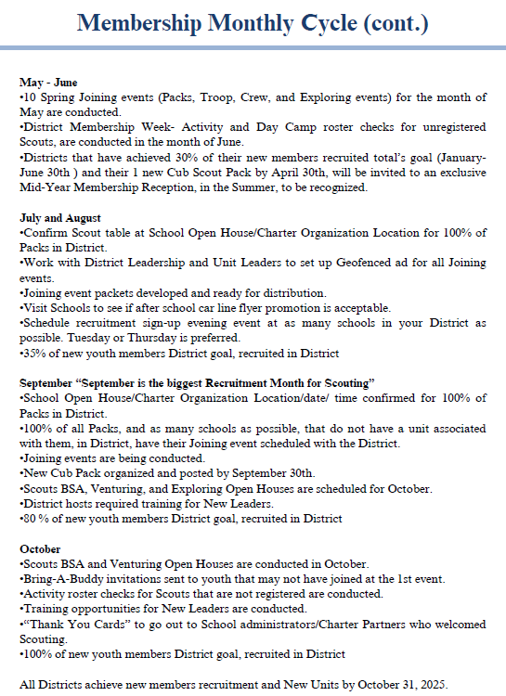

Slide 4
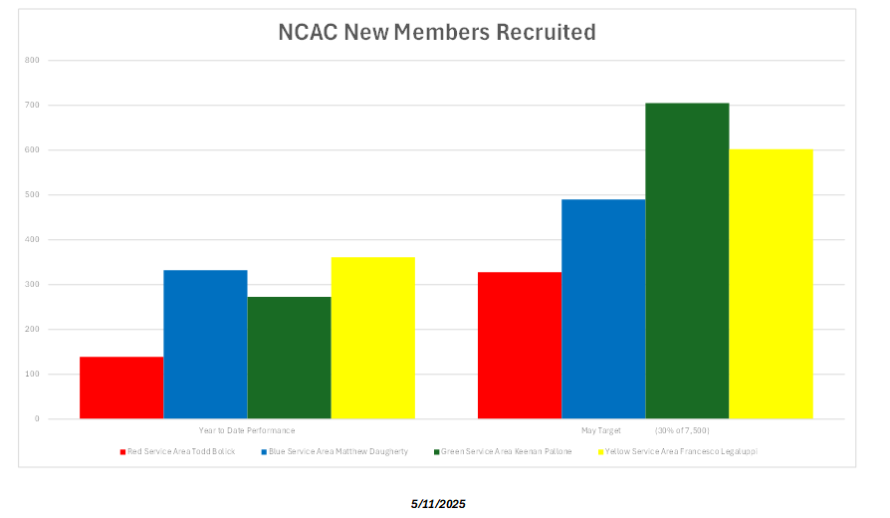

Slide 5
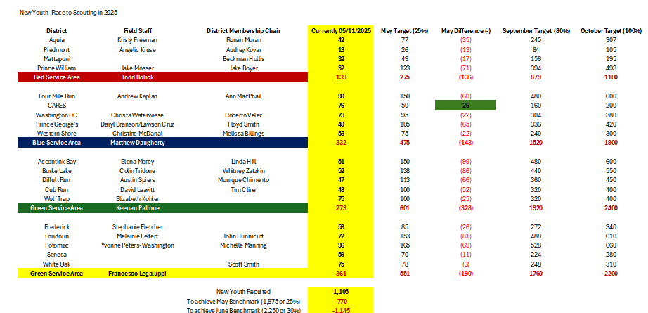
New youth recruited- To-date

Slide 6
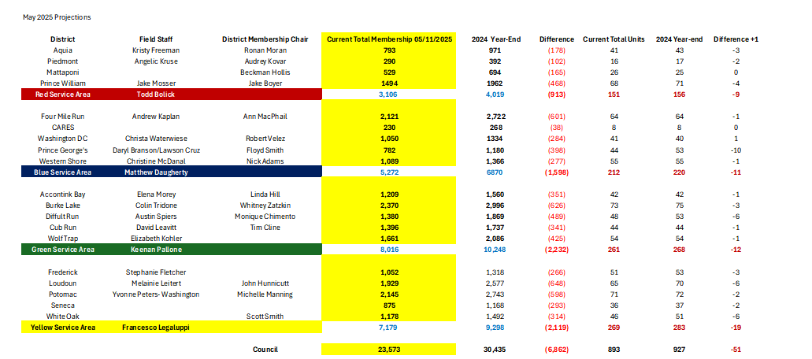
Total youth/Units- To-date

Slide 7
Prep for Fall Recruitment Event
Before the Sign-up Night
Meet with School Administration
Secure interest table at Back-to-School Night, in Summer
Update Unit Be-A-Scout Pin
Develop and approve Pack 12-to-18-month Calendar with events
Confirm Sign-up Night Event Date/Location
Geofence Sign-up Night
Promote Sign-up Night at Back-to- School Night
Have all returning families share on Social Media
Confirm Parent Orientation Meeting time and Location before Sign-up night
Place Yard-signs in the Community and at School
Conduct Scout Talk at School, Charter Organization, etc.
Confirm Troop to help at Sign-up Night

Slide 8
Prep for Fall Recruitment Event
Sign-up Night
Register New Scouts at this event
Submit payment confirmation for online or paper application, at joining event
Submit sign-in sheet to District Representative
Preview upcoming Pack events and meeting dates
Invite Parents to Parent orientation meeting
Keep Meeting to 1-hour

Slide 9
Section: Please review the Joining Night Event Guide to talk about the 5 Stations of the Joining Event
Instructions: Click link below to open or highlight link to open
Fall_Recruitment_Handbook_2025_FINAL.pdf

Slide 10
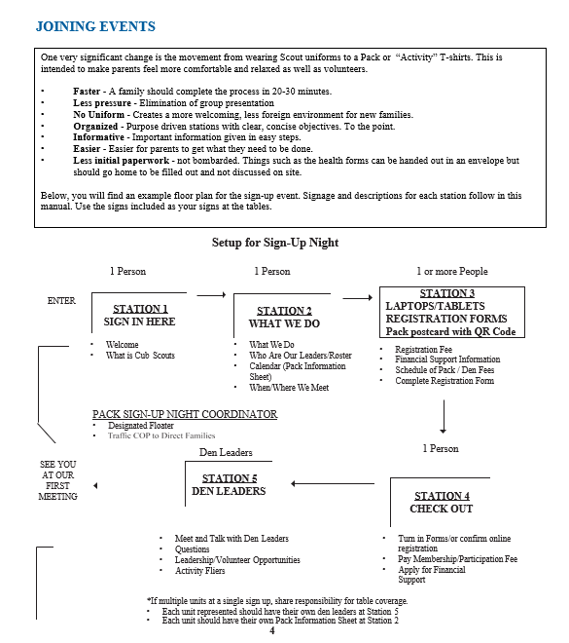

Slide 11
Prep for Fall Recruitment Event
Parent orientation post Joining Night Event
Only Parents attend this meeting
Keep the meeting to 1-hour
Discuss the important role that each parent can do, to make the Pack successful
Discuss more in-depth about what it takes to be fully trained
Assign small introductory tasks to new parents
Inform parents of first den meeting
Distribute calendar of district activity dates including training
Follow-up with incomplete youth applications who did not sign-up at Joining event
Discuss the importance of attending roundtable
Collect applications from all new adult leaders

Slide 12
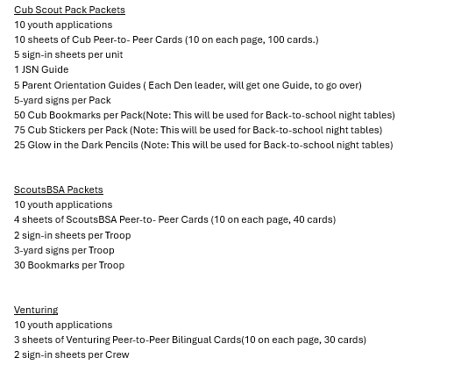

Slide 13
Resources
Financial Support- https://ncacscouting.org/resources/financial-support/
One-Stop-Shop for Recruitment- https://ncacscouting.org/resources/for-leaders/unit-and-district-resources/
Training Opportunities- https://ncacscouting.org/training/
District Information and Contacts-https://ncacscouting.org/service-areas-with-districts/

Slide 14
Ideal Year of Scouting for Cub Scouts
2025-2026-Ideal-Year-of-Cub-Scouting-FINAL.pdf
https://ncacscouting.org/wp-content/uploads/2025/05/Operating_Budget_Worksheet_for_Packs.xlsx

Slide 15
THANK YOU! Let’s grow Scouting!

