Slide 1

2025 Membership Renewal
Training Slides
Ver 13 – 23 Aug 2024

Slide 2
Things To Know
About Membership Renewals
Last year’s recharter system has been retired.
All adults, including parents, need to have a my.scouting account with a valid email address in order to receive email notifications about registration renewals. Everyone needs to add “@scouting.org” to their safe senders list.
All registrations are for 12 months. Registration periods cannot be changed.
The individual membership renewal system was designed for individuals to use Self-Pay. There is no “ACH” or “Pay at Council” options for Self-Pay, only credit card.
Units can pay for some or all of its members, just not at the same time based on expiration dates.
  This will become a monthly process if units elect to pay for their members. They can pay by credit card or ACH payment. There is no “Pay at Council” option for Units. The only exception is for Scouts needing financial assistance until National get a “Discount Code” button affixed in the renewal system.
  One way units can avoid the extra work the unit pay option will create is by having a laptop at the weekly meetings, having the individuals log into their my.scouting account and completing the renewal process, then using the unit credit card/debit card to complete the payment process, as an example.
The ability to attach a new membership app to the renewal has been eliminated.

Slide 3
Things To Know
About Membership Renewals (Con’t)
Change this year is that only the COR/COR Delegate can approve adult renewals or moves. The Committee Chair or Unit Leader and Key 3 Delegates can approve youth renewals.
Fees paid for renewing youth members include the council participation fee which is returned to NCAC by the National Office.
Registration fees paid to the National Office are non-refundable.
If the “Unit Batch Order” sent to National becomes defective, it will freeze that renewal batch until it is resolved by National – it will be up to the unit to clear the defectives.
The Council Registrar does not have a normal role in renewals this year and will have difficulty resolving any defectives, member or fee issues.
Recommendation is to use the Self-Pay option.
Questions can be directed to: ncac.acc.team@ncacbsa.org

Slide 4
Membership Renewals
Individual Self-Pay Option
An e-mail notification with a renewal link will be sent approximately 60 days before membership expires to the email address in their my.scouting account.
There is a link in the notification email that will take them to a renewal page in my.scouting.org so they can renew their membership and pay the registration fees.
If individuals hold multiple positions, these positions will also be renewed unless they chose to Opt-Out of any of them.
The individual then clicks “Proceed to Payment” where they will see a “Terms and Conditions” notification page. The Terms include automatic renewal and billing every year until they Opt-Out.* There will be no “Auto-Renewal” this year. Member then enters their name to agree to the “Terms & Conditions”, then clicks “Go To Checkout”. The payment screen will default to include Scout’s Life magazine but you can “unclick it”.
The individual enters their credit card info and clicks “Place Order”.
A receipt will appear so you can print a copy, then click “Complete Transaction”.
The unit will be notified so they can approve the renewal and complete the process.
* Individuals can delete their credit card info after their renewal has processed.

Slide 5
Membership Renewals
Unit-Paid Option
The Key-3 can elect for the unit to pay any or all membership renewals.
  The Unit Leadership signs in to their My.Scouting account, clicks on Organization Manager, clicks on Settings, clicks the Renewal Payment box, clicks Save.
  When you get an email reminding you that someone’s membership is due:
    Sign in to My.Scouting.org,
    Clicks Organization Manager,
    Clicks Roster,
    Selects the individuals due to renew (shown in the Renewal Status Column),
    Clicks Renew
  Check that the Scout Life selection is correct,
  Review multiple positions, if desired. Change primary position or multiple positions.
    Unit Leadership will need to personally contact any other unit/organization where a member is also registered to confirm where they are paid at and where they are a multiple
Click “Create Renewal Order” to proceed. This will create a “Unit Batch Order”. It cannot be edited, but will be saved, if needed. You can have multiple Batch Orders.
  Check the names in the “Unit Order” area for accuracy.
  Click “Go To Payment” in the Batch area.

Slide 6
Membership Renewals
Unit-Paid Option (Con’t)
Unit Key 3 will get monthly reports on who is due to renew (includes self-pay, too). Units can also pull monthly reports showing who is due to renew, who has renewed or who has Opt-Out.
The Unit can choose not to renew a member (Opt-Out).
The payment screen defaults to the credit card option but note the “ACH Payment” tab next to the credit card. (Fill in the necessary information.)
At the bottom of the page, click “Submit Payment”.
The unit Key-3 will be notified so they can approve the renewal and complete the process. If there are a mix of adults and youth, the Committee Chair/Unit Leader/Key 3 Delegates can approve the youth while the COR or COR-Delegate will need to approve the adults.
If the unit has not set “Auto-Approve” in My.Scouting.org/Organization Manager/Setting, then the unit will need to approve what they just did.
  Click on “Roster”
  Select “Membership Renewal Orders”
  Click “Approve”.
The unit will need to do this almost every month.

Slide 7
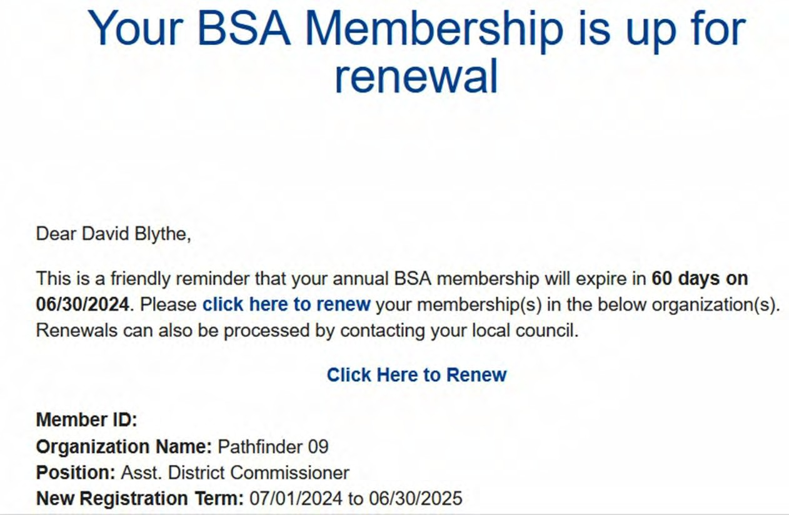
Self-Pay Membership
Renewal Email
Reminders will be sent at 60, 30, 15, and 7 days before, plus several more after expiration.
Parents will receive the emails to renew the membership of youth.
Parents need to create a My.Scouting.org in order to receive the renewal emails.

Slide 8
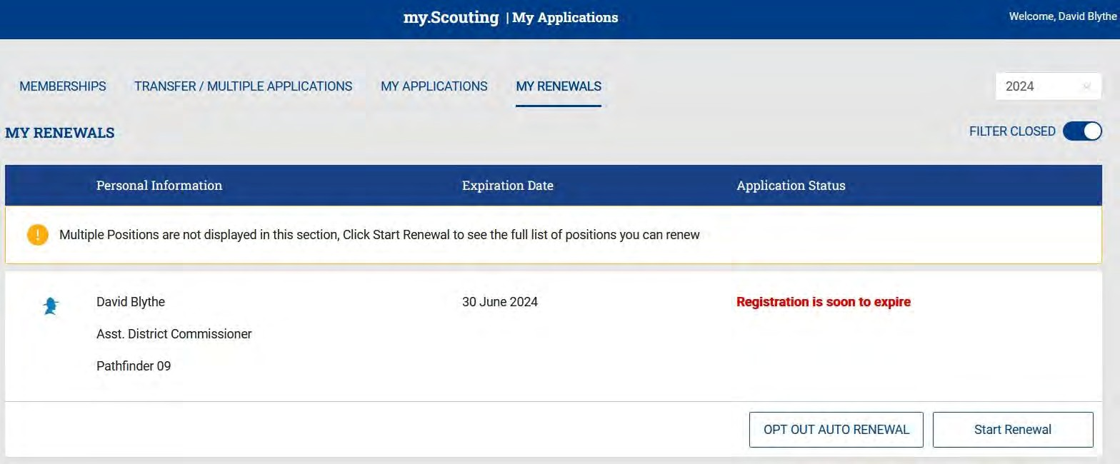
Self-Pay Membership Renewal
When you click the link, you are redirected to sign in to My.Scouting.org; after signing in you will see this screen.
Parents that do not have a My.Scouting account will need to create one.
Note the option to “opt out auto renewal”, this will cancel your registration in BSA – DO NOT CLICK THIS BUTTON. Click Start Renewal to continue with your renewal.

Slide 9
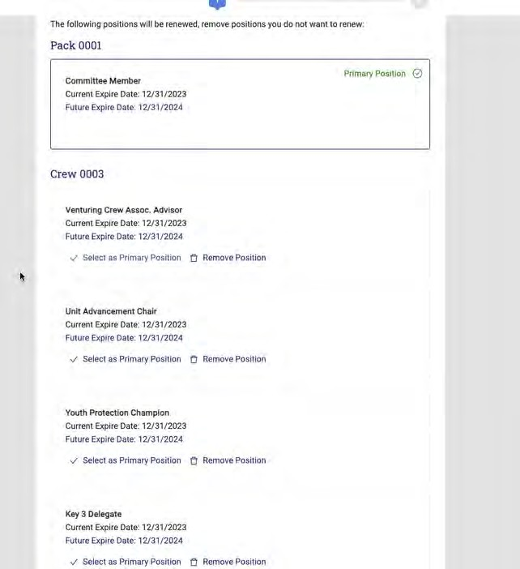
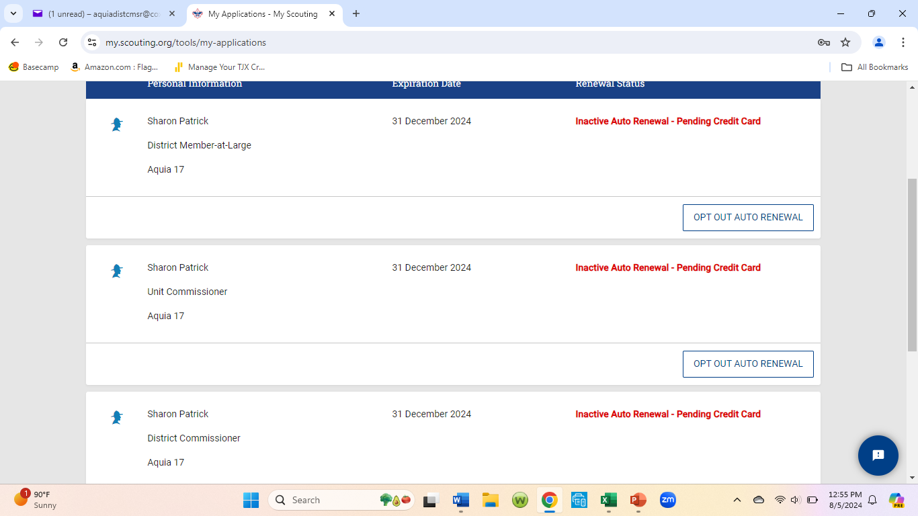
Self-Pay Membership Renewal
Someone with multiple positions (typically an adult) will see a list of them like this.
If desired, you can click the link to change your primary position, or remove yourself from a position. The click “proceed to payment”.
Functional positions, like Key-3 Delegate or Advancement Chair, will not appear here.

Slide 10
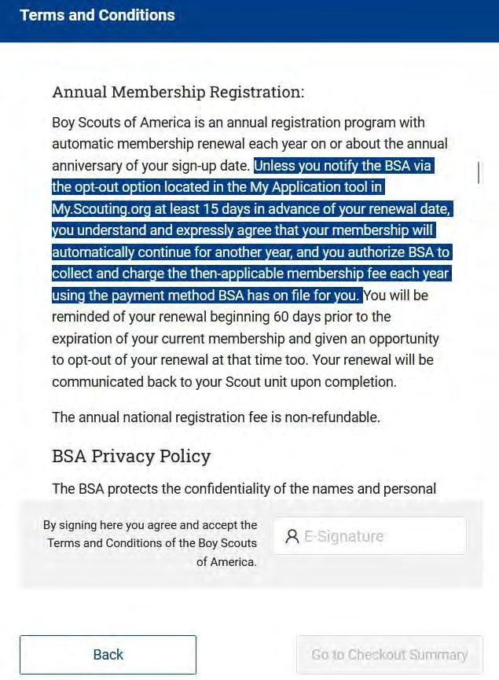
Self-Pay Membership Renewal
Next is the Terms & Conditions.
1 Note that the Terms include automatic renewal and billing every year until you opt out… just like Netflix…!
2. Type your name to agree to the Terms and Conditions.
3. Click go to checkout.
2
3

Slide 11

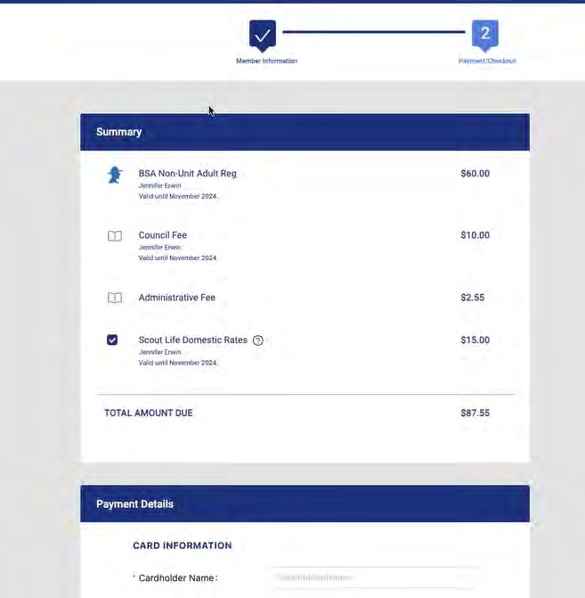
Self-Pay Membership Renewal
On the payment screen the system will default to include Scout’s Life magazine! You can toggle this on or off.
Then enter your credit card information and click Place Order.
There is no “ACH” or “Pay at Council” option for Self-Pay.

Slide 12
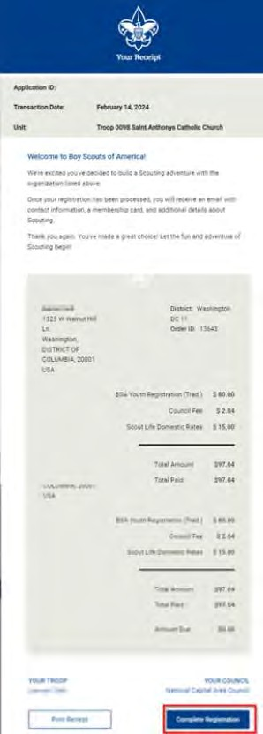
Self-Pay Membership Renewal
A credit card receipt will appear that you can print for your records.
Then click Complete Transaction to finish the renewal.

Slide 13
Self-Pay Membership Renewal
Wrap Up
Emails are sent at 60-, 30-, 15-, and 7-days before the expiration date and will have a follow up email 7-days after the expiration date
The unit will be notified of the member renewal. A Key-3 member must then sign in to My.Scouting, click on Application Manager and accept or deny the Scout membership renewal and then approve it at the bottom of the page. Units can opt-out of this step by setting up “Auto-Approve”. Only the COR/COR-Delegate can approve adult renewals.
The Key-3 will get monthly reports on who is due to renew, who did and who Opt-Out.
All multiple positions are renewed simultaneously with the primary position.
There is no mechanism for tracking bounce-back or failed e-mails. Reminders by text are not available.
If someone renews their membership, and the unit folds after, the person moves to “Member without a Unit” pending their reassignment into a new position unit.
The member can opt out to let their membership expire.

Slide 14
Membership Renewal
Unit Paid Option
Units have a choice to make on membership renewal.
Membership renewal can be completed by either the individual using the Self-Pay option or
the Unit can elect to pay for some or all of its members based on their expiration date.
In My.Scouting/Organization Manager, the unit selects the Unit Pay option.
Unit Key-3 will get monthly reports on who is due to renew (this report includes self-pay, too.)
Using the My.Scouting/Roster tab, the unit selects which members they are renewing.
The unit can choose not to renew a member (opt-out). The unit can also change the Scout’s
Life subscription settings for each person.
The unit pays with a credit card or a securely stored electronic fund transfer (ACH), and submits the renewal.
Selecting Unit Pay will NOT eliminate the reminder emails to each family until the renewal batch is processed. This will lead to confusion.

Slide 15

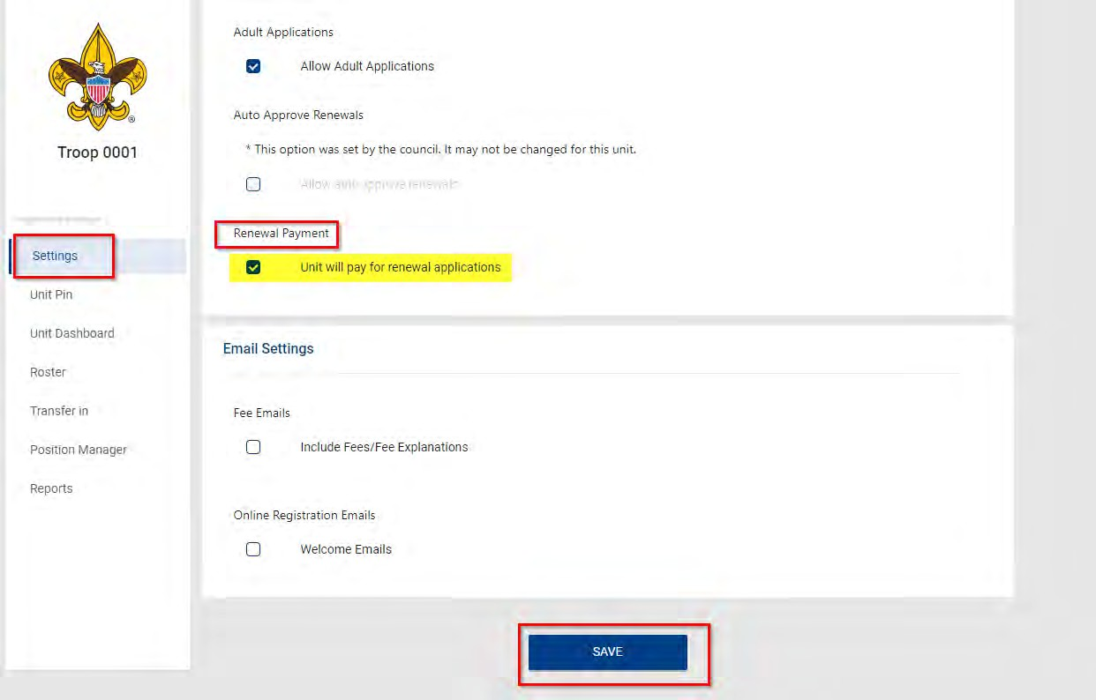
Membership Renewals
3
4
5
The Key-3 can select for the unit to pay any or all membership renewals.
Sign-in My.Scouting.org, click Organization Manager,
3. Click “Settings”,
4. Click the “Renewal Payment box”,
5. Click the “Save”.

Slide 16
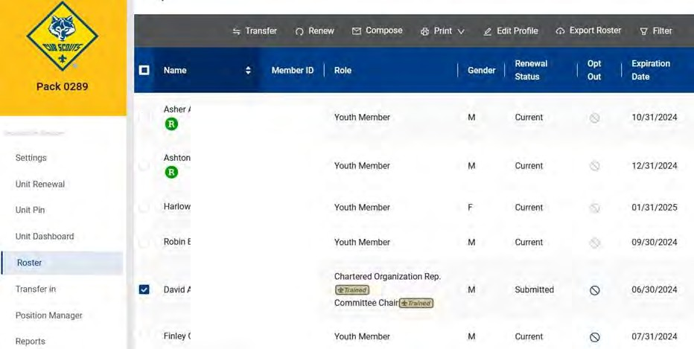
Membership Renewals
3
1
2
Eligible to
Renew
When you get an email reminding you that someone’s membership is due:
Sign-in to My.Scouting.org, and click “Organization Manger”
Click “Roster”
Select the individuals due to renew (See Renewal Status Column)
Click “Renew”
Note: You will need to do this almost every month.

Slide 17

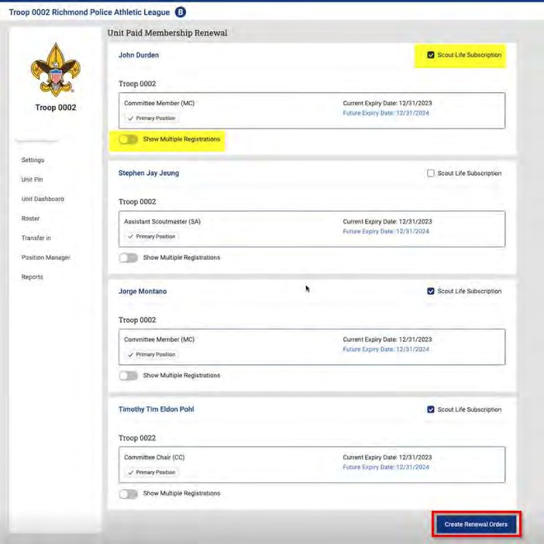
Unit-Pay Membership Renewals
1
2
1
3
Check that the Scout Life selection is correct; the system defaults to “yes, subscribed”
Review multiple positions, if desired. You can change the primary position or change multiple positions, as appropriate.
3. Click “Create Renewal Order” to proceed.

Slide 18
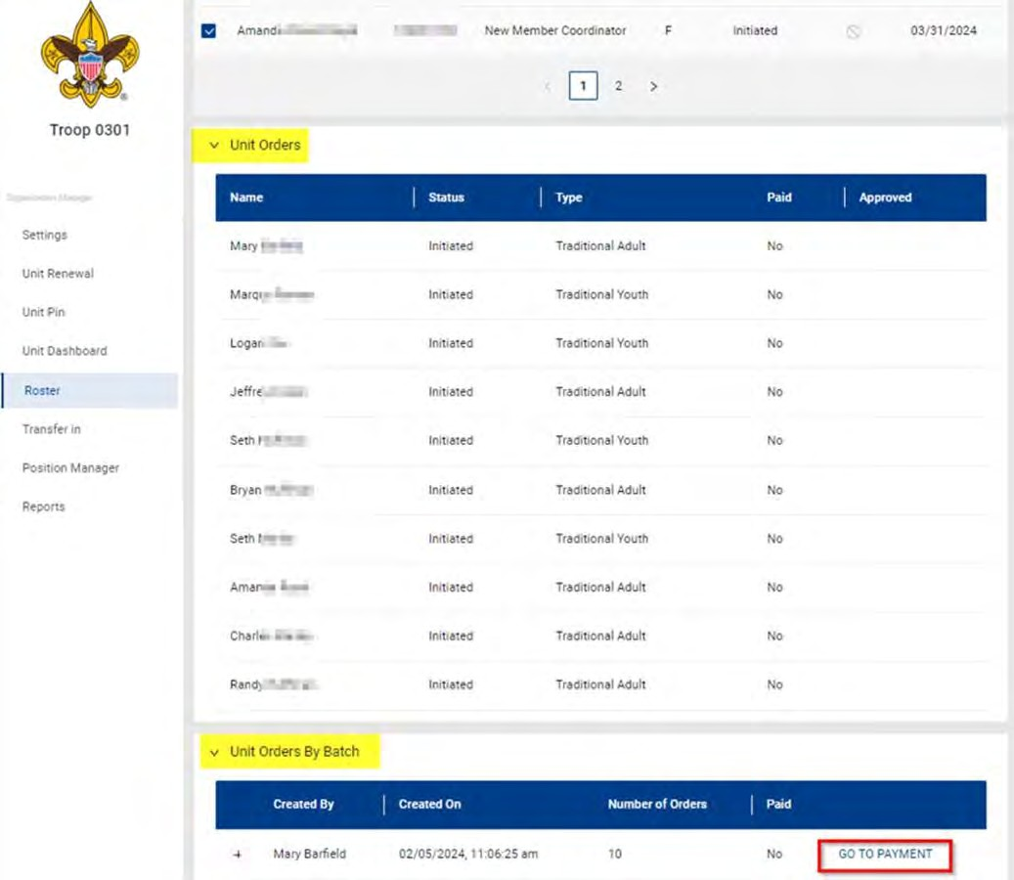
Unit-Pay Membership Renewals
1
2
This will create a “Unit Batch Order”. It cannot be edited, but will be saved if needed.
You can have multiple batch orders.
1. Check the names in the “Unit Order” area for accuracy
2. Click “Go To Payment” in the Batch area.

Slide 19
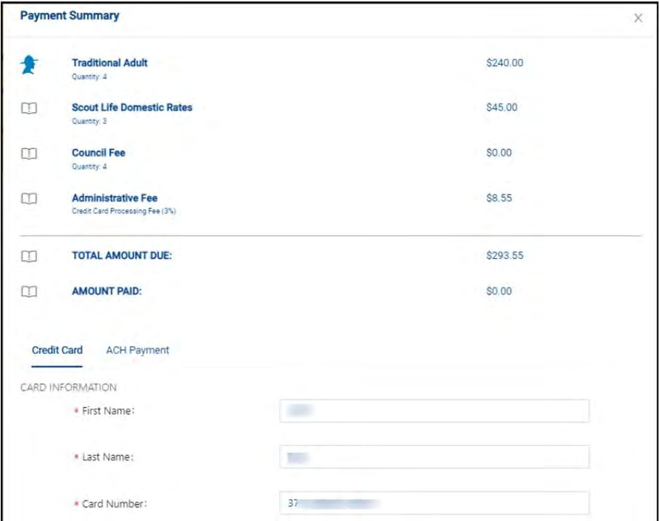
Unit-Pay Membership Renewals
The payment screen defaults to the credit card option, but note the “ACH Payment”
Tab next to the Credit Card option. There is no “Pay at Council” option.
At the bottom of the page, click to “Submit Payment”.

Slide 20
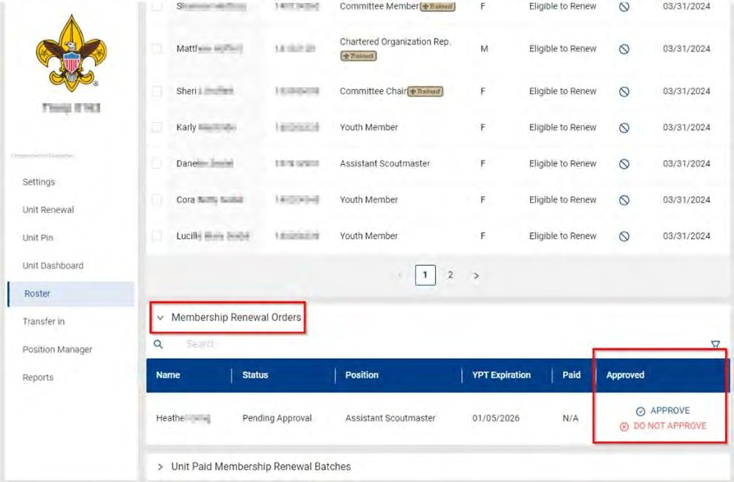
Unit-Pay Membership Renewals
1
2
3
If you have NOT set “Auto-Approve” in My.Scouting.org/Organization Manager/Settings for youth renewals, then you will need to approve what you just did:
Click on “Roster”.
Select “Membership Renewal Orders”, COR/COR-Delegate approves adult renewals.
Click “Approve”.
After each renewal, conduct a membership inventory by comparing the unit's local (Scoutbook+) roster to the my.scouting roster to confirm members are renewed correctly.

Slide 21
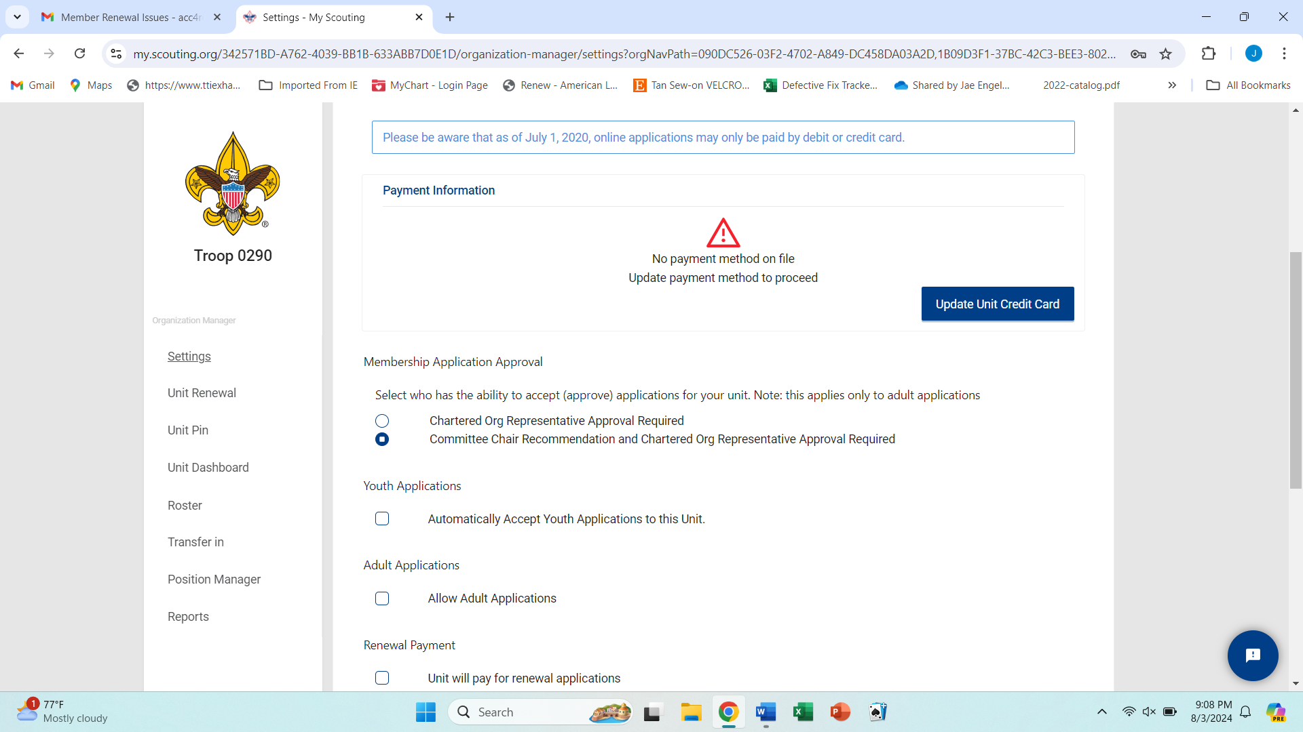
Setting Up Auto-Approval for
Membership Renewal
To activate the
Auto Approve feature:
1. Go to My.Scouting,
2. Select Organization
Manager,
3. Select Settings,
4. Click the box for
"Allow Auto Approve",
5. Click Save at the bottom of the page.
By setting up the “Auto-Approve” feature this will preclude the unit having to approve every renewal.
3
4

Slide 22
Unit-Pay Membership Renewals Wrap Up
In My.Scouting/Organization Manager/Settings, the unit selects the Unit Pay option.
Unit Key-3 will get monthly reports on who is due to renew (this report includes self-pay, too).
Using the My.Scouting/Roster tab, the unit selects which members they are renewing.
The unit can choose not to renew a member (opt-out). The unit can also change the Scout’s Life subscription settings for each person.
The unit pays with a credit card or a securely stored electronic fund transfer payment (ACH) and submits the renewal. There is no “Pay at Council” option.
As with self-pay, the unit must accept the membership renewal in My.Scouting, although they can avoid this by selecting “Auto-Approve” in My.Scouting/Organization Manager/Settings.
Unit-pay does not preclude an individual from using the self-pay function. If they do, the unit will be blocked from double-paying. If the unit pays first, the individual will be blocked from double-paying.
This will eventually become a monthly process for the unit and its leadership?
After each renewal, conduct a membership inventory by comparing the unit's local (Scoutbook+) roster to the my.scouting roster to confirm members are renewed correctly.

Slide 23
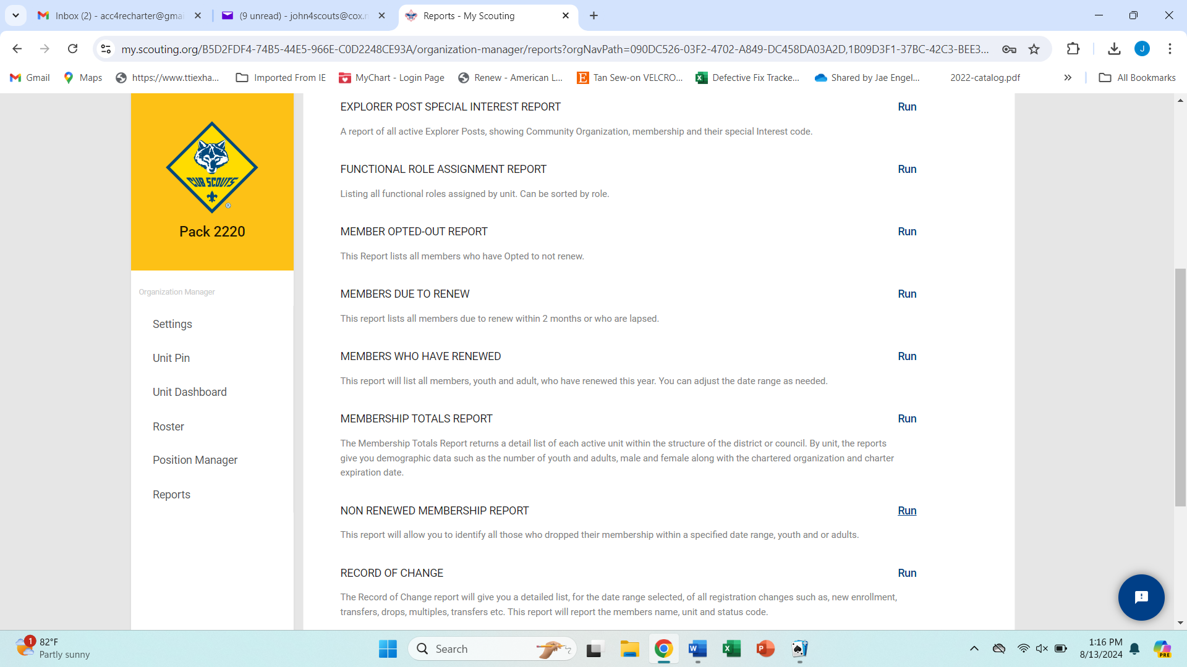
Checking Membership Renewal Status
Note that you can click on the Reports option to generate a report of upcoming membership dates:
Sign in to My.Scouting.org,
Click “Organization Manager”,
Click “Reports”,
Select the desired report.

Slide 24
Financial Assistance
For all youth members of the BSA
Individuals needing to apply for financial assistance should submit the financial assistance form directly to council prior to renewing. Upon receiving approval for aid, the member completes the renewal up to the payment step. The member should print the renewal application and turn in the renewal and aid approval along with payment for fees not covered by the aid to their unit Committee Chair. It will be forwarded to the council registrar to process the renewal and pay National. Individual renewals will normally occur every month on the anniversary of a member’s joining date or last renewal. The responsibility for renewing is an individual responsibility.
If financial assistance is needed, submitters must “Pay at Council”. There is no current way to pay partial fees to National. National is working on a “Discount button” to allow payment for folks needing financial assistance.
  Individuals can find the Financial Support – Family form at the following link
  https://247scouting.com/forms/082-FinancialSupport
  Units can find the Financial Support – Unit Leader Edition at the following link
  https://247scouting.com/forms/082-FinancialSupportUnitLeader
Financial assistance is available to not only current Scouts but to new Scouts as well.
  Individuals needing financial assistance for their Scouts need to apply before their expiration date
  New Scouts needing financial assistance will need to complete the appropriate form along with a paper Scout application and send them to the NCAC Council office Registrar

Slide 25
Opt-Out Function
For all youth and adult members of the BSA
This year the Opt-Out function serves to drop individuals from the Scouting program.
If an individual accidentally opt outs of their paid position, the member can still renew their membership during the lapse period. After the lapse period expires, the member would need to complete a new application to rejoin Scouting.
For members who Opt-Out by accident they can send an email to their District Commissioner with their name, BSA ID #, and unit. The District Commissioner can forward that information to the Council Registrar who can reset the member in the system.

Slide 26
Questions can be sent to:
  acc4recharter@gmail.com
  or
  ncac.acc.team@ncacbsa.org

